Slide 1
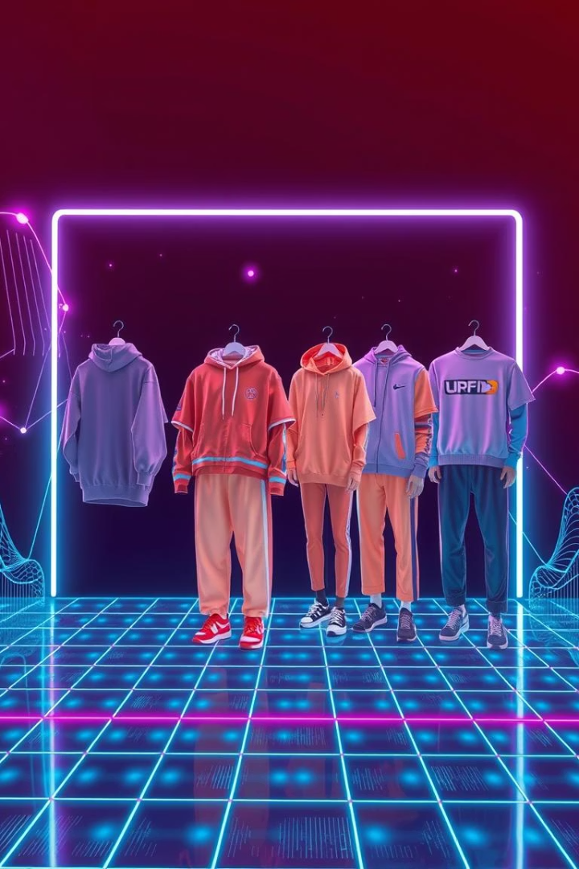
Fashion Item Classification with Fashion MNIST
This presentation details building an image classifier to categorize clothing items using the Fashion MNIST dataset, with results visualized via a confusion matrix.
Team Memebers
1.Priyesh Kumar - 202401100300186
2.Rishabh Sharma - 202401100300200
3.Ritesh Bhaskar - 202401100300202
4.Ram Avatar Chaudhary - 202401100300195
5.Satyam Singh - 202401100300218

Slide 2


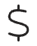


Problem Statement
Manual categorization: Time-consuming
E-commerce needs automation
Accurate and efficient systems.
Prone to human errors.
Challenge: Low-resolution images
Goal: High classification accuracy
28x28 grayscale classification.
Precise clothing item identification.

Slide 3
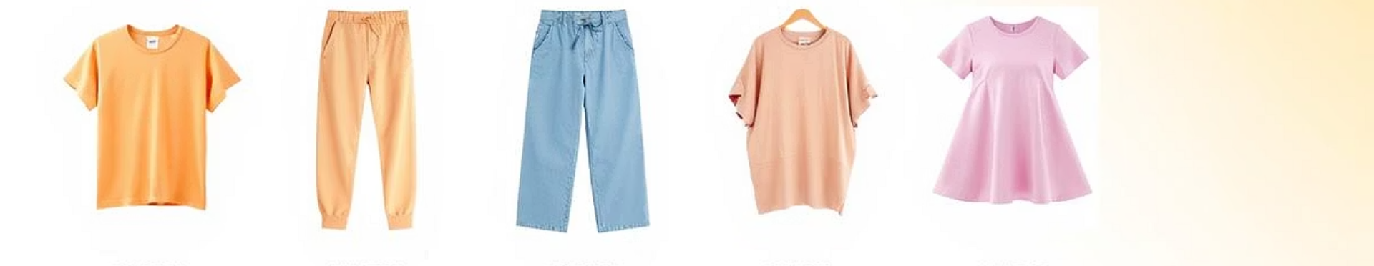




Introduction to Fashion MNIST
Zalando's dataset
70,000 grayscale images
Training & testing split
Diverse examples
Drop-in MNIST replacement.
60,000 train, 10,000 test.
T-shirt, Trouser, Sandal, Bag.
10 fashion categories.

Slide 4





Methodology: Data Preparation
Load dataset
Fashion MNIST data loading.
Normalize data
Scale pixel values to [0, 1].
Split data
80% training, 20% validation.
One-hot encode labels
Categorical classification readiness.

Slide 5
Methodology: Model Architecture
CNN Architecture
Example Architecture
Convolutional and Max Pooling layers.
Conv2D (32 filters, 3x3 kernel)
ReLU activation
MaxPooling2D (2x2 pool)
Flatten layer
Flatten layer
Dense layers
Dense (128 units, ReLU)
Softmax activation
Dense (10 units, Softmax)

Slide 6
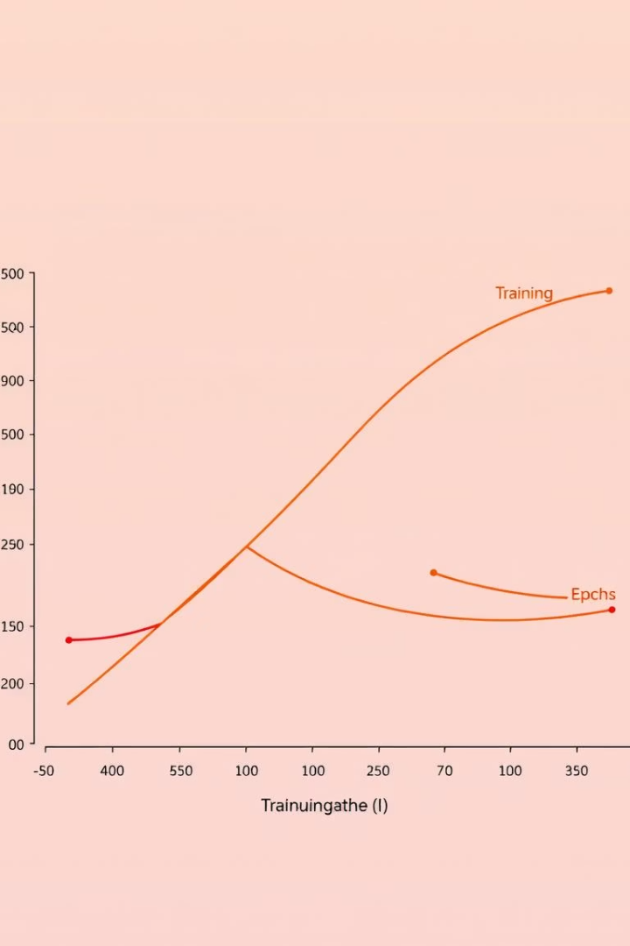
Methodology: Training and Evaluation
Training parameters
Adam optimizer, categorical cross-entropy loss.
Configuration
Batch size 128, 20 epochs.
Prevent overfitting
Monitor validation loss.
Evaluation metrics
Accuracy, Precision, Recall, F1-score.

Slide 7
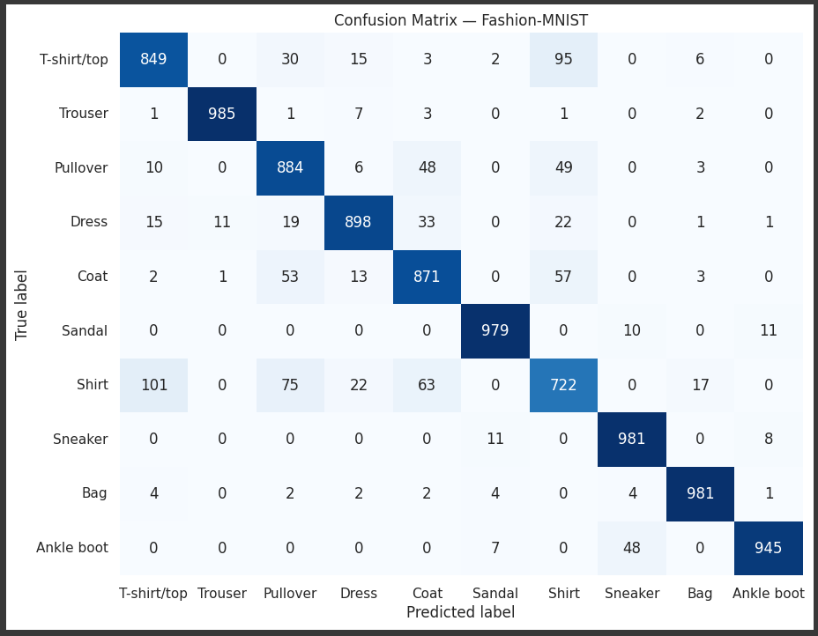
Results: Performance Metrics

Slide 8
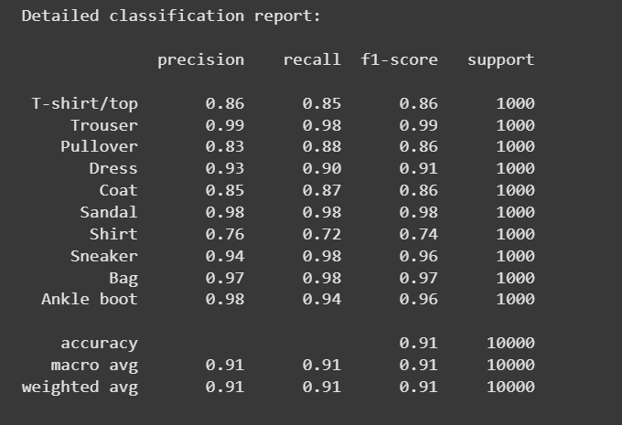
Shirt vs Pullover
Sandal vs Sneaker
The chart illustrates common misclassifications, such as Shirt often being confused with Pullover, and Sandal with Sneaker.

Slide 9

Conclusion
High Accuracy
Fashion MNIST classification successful.
CNN model effective.
Insights from Confusion Matrix
Identified common errors.
Valuable for model refinement.
Applications
E-commerce optimization.
Inventory management.
Fashion trend analysis.
Future Work
Improve accuracy.
Deploy model for real-time processing.

Slide 10

THANK YOU

